Slide 1
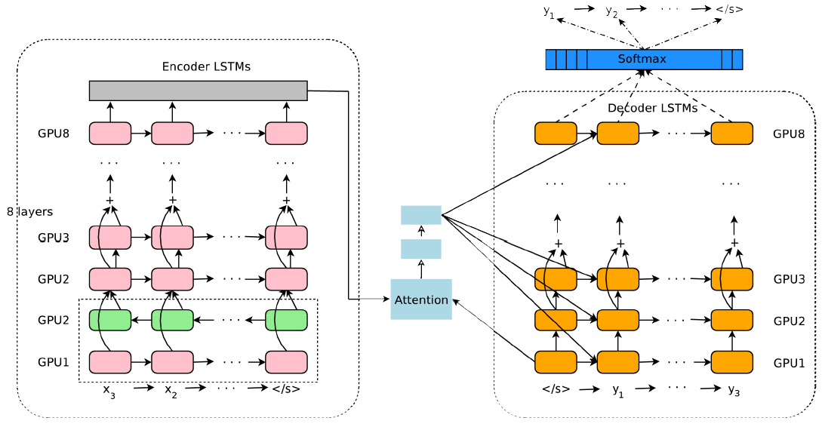
Encoder端为何不使用多层Bi-RNN

Slide 2
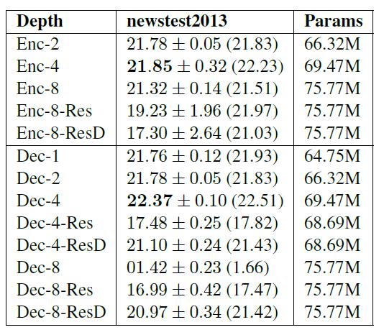
Encoder端为何不使用多层Bi-RNN
Massive Exploration of Neural Machine Translation Architectures
Google’s Neural Machine Translation System: Bridging the Gap between Human and Machine Translation
单向RNN并行化程度更高

Slide 3
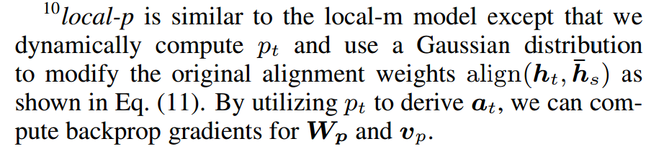
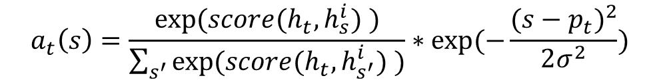


Local Attention中正态分布的作用
$${p_{t}=S∙sigmoid(v_{p}^{⊺}tanh⁡(W}_{p}h_{t}))$$
$$window=[p_{t}−D,p_{t}+D]$$
$$a_{t}\left(s\right)=\frac{exp⁡({score(h}_{t},h_{s}^{i}) )}{\sum_{s^{′}}{exp⁡({score(h}_{t},h_{s^{′}}^{i}) )}}∗exp⁡(−\frac{⁡{(s−p_{t})}^{2}}{2σ^{2}})$$

Slide 4
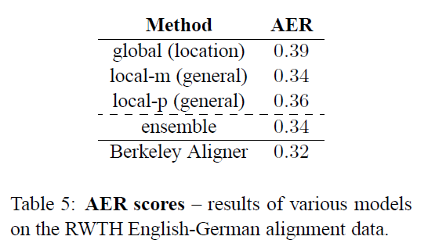
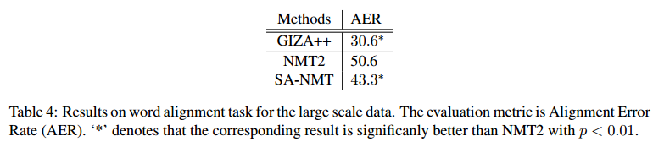
如何转化Attention的词对齐
Effective Approaches to Attention-based Neural Machine Translation
Neural Machine Translation with Supervised Attention
Alignment Error Rate (AER)
AER = 1 - (|A∩S| + |A∩S|) / (|A| + |S|)
Attention: one-to-one alignments
Aligner: one-to-many alignments

Slide 5
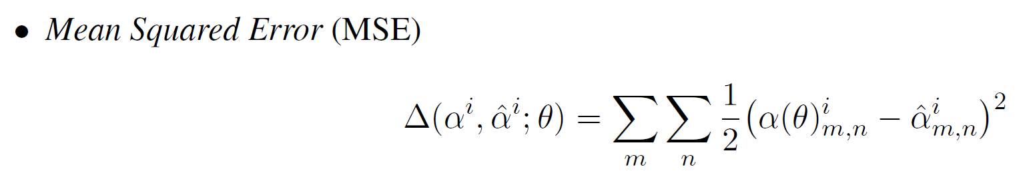
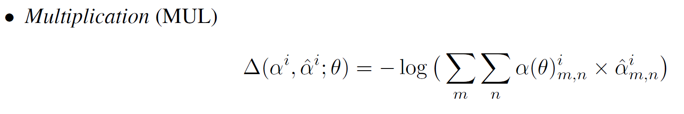
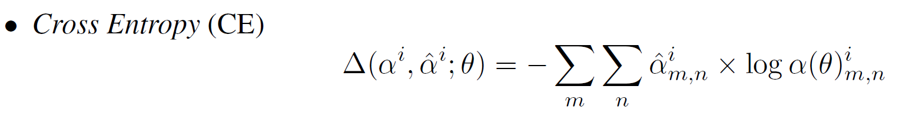
几种方法的优缺点？

